Slide 1
Graphical Representation

Slide 2





www.tuf.edu.pk
unioffaisalabad
GRAPHICAL REPRESENTATION: The Visual representation of statistical data in the form of points, lines, areas and other geometrical forms and symbols is known as graphical representation. Such visual representation can be divided in to two groups.
(i) Graph (ii) Diagram
The basic difference between a graph and a diagram is that a graph is a representation of data by a continuous curve, usually shown on graph paper while a diagram is any other one, two or three-dimensional form of visual representation.

Slide 3
www.tuf.edu.pk
unioffaisalabad
Diagrams: Diagram is a device used for representing a statistical data in such a way that it provides maximum information’s about the movement of the data.
Advantages of Diagrams:
The diagrams are good looking and attractive.
The diagrams leave more effective and long lasting impression on the mind of a reader.
The diagram make it easier to compare two or more things at a time.
Disadvantages of Diagrams:
The diagrams are less accurate than tables.
The diagrams have cost money and time and the amount of information conveyed is limited.

Slide 4
www.tuf.edu.pk
unioffaisalabad
Types of Diagrams:
Different types of diagram or charts commonly used for displaying statistical data are described below:
Simple Bar Diagram/Chart
Multiple Bar Diagram/Chart
Sub-divided or Component Bar Diagram/Chart
Pie Diagram/Chart

Slide 5
www.tuf.edu.pk
unioffaisalabad
Simple bar chart/Diagram:
A Simple bar chart consists of horizontal or vertical bars of equal widths and lengths proportional to the magnitudes of the observations. The space separating the bars should not exceed the width of the bar and should not be less than half of its width. The data when do not relate to time should be arranged in ascending or descending order before charting.

Slide 6
www.tuf.edu.pk
unioffaisalabad
Multiple bar chart/Diagram:
A Multiple bar chart shows two or more characteristics corresponding to the values of a common variable in the form of grouped bars whose lengths are proportional to the values of the characteristics and each of which is shaded or colored differently for identification. OR
It is an extension of simple bar chart and is used to represent two or more related sets of data in the form of groups of bars side by side. Multiple bar charts provide more information’s about the same problem.

Slide 7
www.tuf.edu.pk
unioffaisalabad
Sub-divided/component bar chart/Diagram:
In Component bar chart, each bar is divided into two or more sections. The length of the bar represents the total and various sections represent the components of total. OR
Sub-divided bar chart is obtained by dividing simple bar chart in to different components.

Slide 8
www.tuf.edu.pk
unioffaisalabad
Pie diagram/Diagram: A Pie diagram consists of a circle divided into sectors whose areas are proportional to the various parts into which the whole quantity is divided. OR
A Pie diagram is the division of a circular region into different sectors of any convenient radius. It is constructed by dividing the total. As a circle consists of 360ºis divided into different components.

Slide 9
www.tuf.edu.pk
unioffaisalabad
Graphs: Graph means the drawing of geometrical curves in conformity with the given data. It is a representation of data by a continuous curve.
Advantages of Graphs:
Graphs are most effective way to represent data.
Graphs are the most effective way to compare two sets of data at a time.
Graphs are helpful to show the general trend of data.
Graphs are helpful in prediction and forecasting.
Graphs are useful to locate some of the averages.

Slide 10
www.tuf.edu.pk
unioffaisalabad
Types of graphs:
Different types of graphs are commonly used for displaying statistical data are described below:
Historigram/Graph of time series
Histogram
(iii) Frequency polygon & Frequency curve
(iv) Cumulative Frequency polygon or Ogive

Slide 11
www.tuf.edu.pk
unioffaisalabad
Historigram/Graph of time series:
A graph of time series is called historigram. A Historigram is constructed by taking time along X-axis and the value of the variable along Y-axis. Points are plotted and are then connected by straight line segments to get the Historigram.
Histogram:
Histogram is the graphical representation of frequency distribution by a set of adjacent rectangles in which area of each rectangle is proportional to the corresponding frequency. In the construction of histogram class boundaries taking along the X-axis and whose height are proportional to the frequencies with respective classes (frequency along Y-axis).But in case of unequal class interval adjusted frequency is used in place of frequency where adjusted frequency is obtained by dividing the frequency to the class interval.

Slide 12
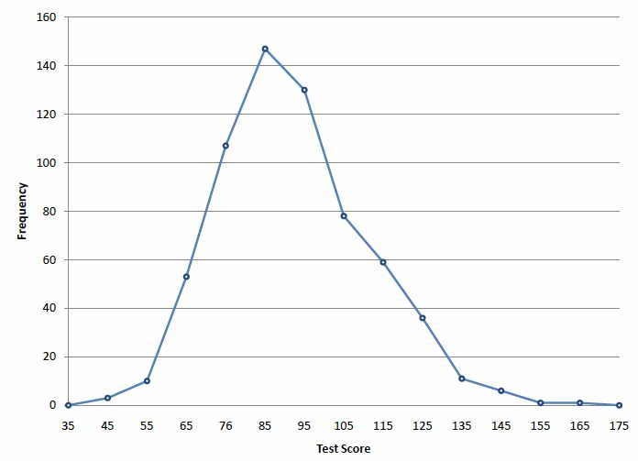
www.tuf.edu.pk
unioffaisalabad
Frequency polygon:
A frequency polygon is a line graph of frequency distribution in which the frequencies are plotted against the mid points of the classes. Itis constructed by taking the midpoints along X-axis and class frequency along Y-axis. Points are plotted and are then connected by straight line segments. But to get a polygon* add extra class midpoint at both ends of the distribution with zero frequency so that the polygon does form a closed figure with the horizontal axis.

Slide 13
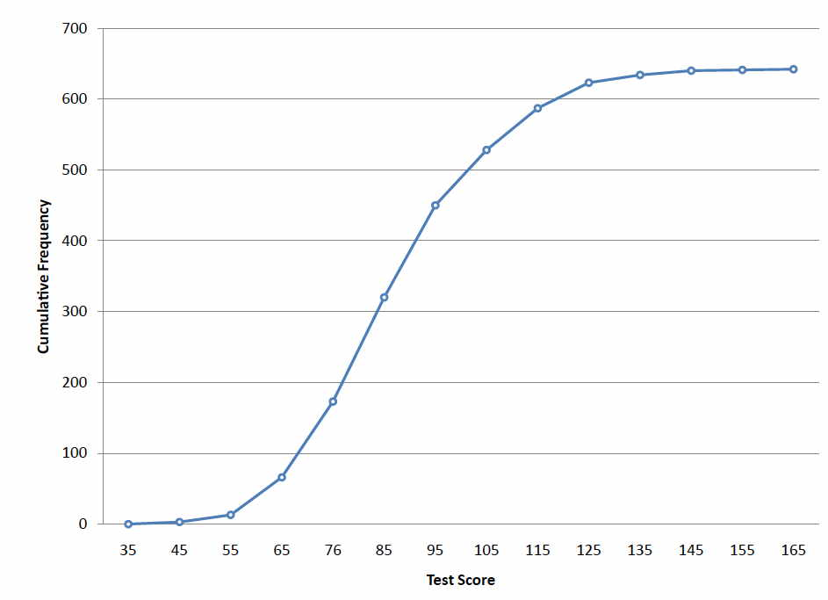
www.tuf.edu.pk
unioffaisalabad
Cumulative frequency polygon/Ogive:
A Cumulative frequency polygon is obtained by plotting the cumulated frequency (along Y-axis) against the upper-class boundaries (along X-axis) and the points are joined by straight line segments. To get a polygon include lower class boundary of the first class with zero frequency and joined the last point with the last upper class boundary.

Slide 14
www.tuf.edu.pk
unioffaisalabad
Frequency curve:
If the frequency polygon is smoothed out, the resulting graph is called a frequency curve. OR
A frequency curve is constructed by taking the midpoints along X-axis and class frequency along Y-axis. Points are plotted and are then connected by free hand curve.

